Slide 1


Under The Guidence Of
Dr.Anita Dixit
Dr.Rajashekarappa
SDM COLLEGE OF ENGINEERING AND TECH DHARWAD
Dept of Information Science And Engineering
DBMS Project On
“BOOKSHOP MANAGEMENT SYSTEM”
Presented By:
Aditya S Honnakasturi | 2SD23IS006
Pratham Hegde | 2SD23IS034
Kiran Jantgal | 2SD24IS402
Pradyumna | 2SD23IS032

Slide 2
Brief Introduction:
Bookshop Management System automates day-to-day bookshop operations.
  It helps in organizing and maintaining information related to books, customers, employees, orders, authors, and billing.Reduces manual effort and improves data accuracy.
  It allows users to search books, place orders, generate bills, and track stock quantity easily,Implements core database concepts.
  The system replaces manual record-keeping with a centralized database, reducing errors and redundancy.
  The database is designed using primary keys and foreign keys to maintain proper relationships.

Slide 3
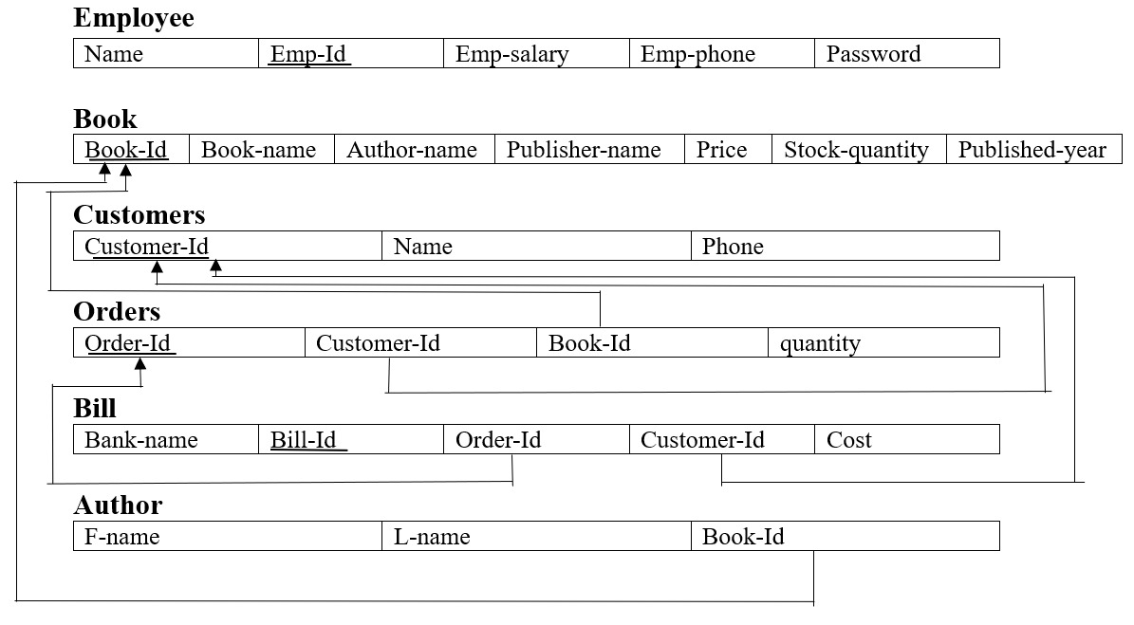
Schema Diagram:

Slide 4
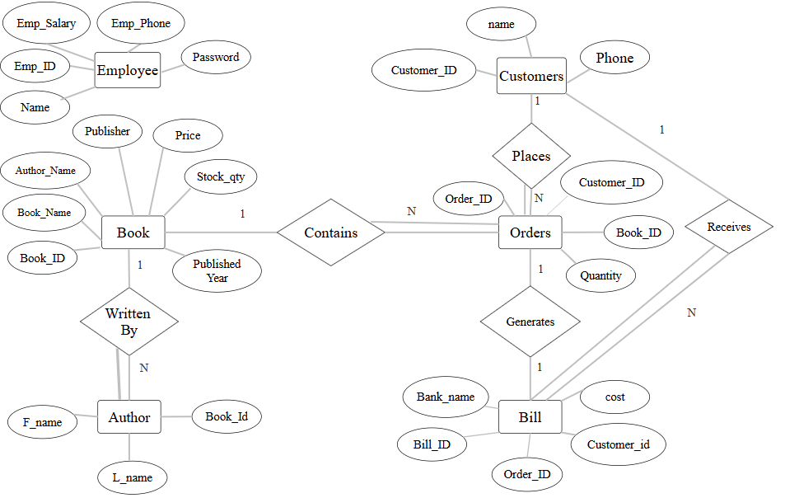
ER Diagram:

Slide 5
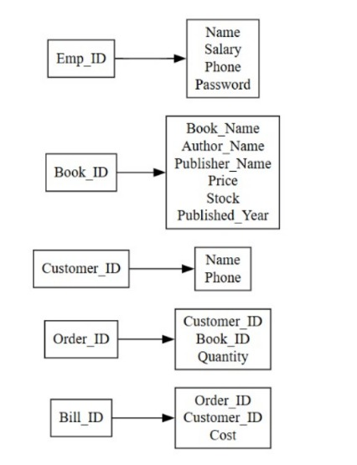
Functional Dependency:
-> Functional dependency is a relationship where one attribute uniquely determines another attribute in a relation.

Slide 6
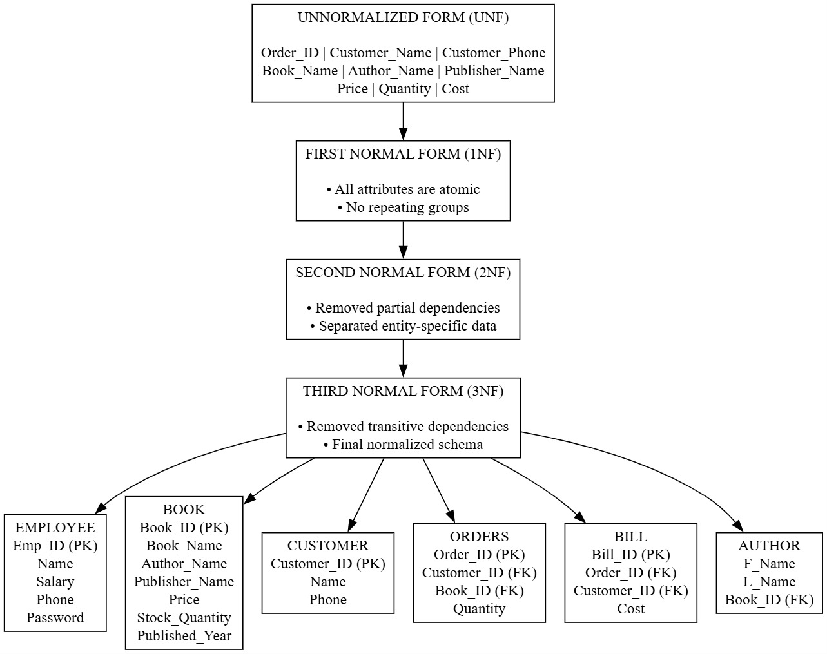

Slide 7
Project Implementation:
Implemented using MySQL + PHP (XAMPP)
CRUD operations for:
->Books
->Customers
->Orders
->Billing
Database connected with frontend forms.

Slide 8
Thank you

